Slide 1
Cryptography & Network Security AAT
Blowfish Algorithm
Umang Goel (1BM20CS176)
Vishnu Kumar (1BM20CS190)

Slide 2
01
OVERVIEW
What Blowfish is all about

Slide 3
What is Blowfish ?
Blowfish is an encryption technique designed as an alternative to DES Encryption Technique and International Data Encryption Algorithm (IDEA) encryption algorithms. It is significantly faster than DES and provides a good encryption rate with no effective cryptanalysis technique found to date. It is one of the first, secure block ciphers not subject to any patents and hence freely available for anyone to use.
it couldn't completely replace DES due to its small block size, which is considered insecure.
Blowfish features a 64-bit block size and takes a variable-length key, from 32 bits to 448 bits. It consists of 16 Feistel-like iterations, where each iteration operates on a 64-bit block that's split into two 32-bit words. Blowfish uses a single encryption key to both encrypt and decrypt data.
Notes:
Feistel cipher, symmetric key, 56key bits, insecure. P S Boxes
(IDEA) is a symmetric key block cipher encryption algorithm designed to encrypt text to an unreadable format for transmission via the internet.

Slide 4
The Blowfish algorithm consists of two major parts:
Data encryption : Data encryption happens through a 16-round Feistel network, with each round consisting of a key-dependent permutation and a key- and data-dependent substitution. Large, key-dependent S-boxes work with the substitution method and form an integral part of the data encryption system in Blowfish. All encryption operations are XORs -- a type of logic gate -- and additions on 32-bit words.
Key expansion and subkeys : In the key expansion process, maximum size 448-bit keys are converted into several subkey arrays totaling 4,168 bytes. Subkeys form an integral part of the Blowfish algorithm, which uses a large number of them. These subkeys are pre-computed before encryption or decryption can take place.

Slide 5
The subkeys are calculated as follows:
The P-array and S-boxes are initialized with a fixed string of hexadecimal digits of pi.
2. The first element in the P-array (P1) is now XORed with the first 32 bits of the key, P2 is XORed with the second 32-bits and so on, until all the elements in the P-array are XORed with the key bits.
3. All-zero strings are encrypted by the algorithm as described in the above steps.
4. P1 and P2 arrays are replaced with the output from step 3 above.
5. This output is encrypted by Blowfish with modified subkeys.
6. The output of step 5 modifies P3 and P4 in the P-array.
7. This process continues until all the P-arrays and four S-boxes are modified.
In total, Blowfish runs 521 times to generate all the subkeys and processes -- about 4 kilobytes (KB) of data.

Slide 6
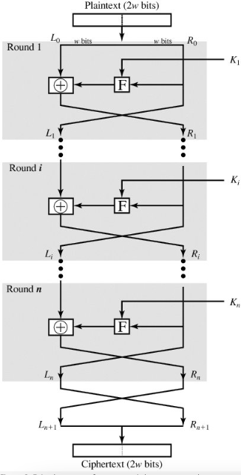
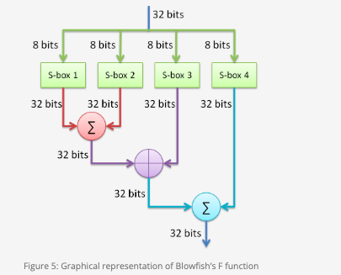

Slide 7
Working
Assume the message "Hi world" is to be encrypted with Blowfish. The following are the steps involved:
Initially, the input "Hi world" consists of seven characters plus one space, which is equal to 64 bits or 8 bytes.
The input is split into 32 bits. The left 32 bits -- "Hi w" -- are XORed with P1, which is generated by key expansion to create a value called P1.
Then, P1 runs through a transformative F-function in which the 32 bits are split into 4 bytes each and passed to the four S-boxes.
The first two values from the first two S-boxes are added to each other and XORed with the third value from the third S-box.
This result is added to the output of the fourth S-box to produce 32 bits as output.
The output of F In is XORed with the right 32 bits of the input message -- "orld" -- to produce output F1'.

Slide 8
Blowfish encryption/decryption
Then, F1' replaces the left half of the message, while P1' replaces the right half.
This same process is repeated for successive members of P-array for 16 rounds in total.
Finally, after 16 rounds, the outputs P16' and F16' are XORed with the last two entries of the P-array, i.e., P17 and P18. They are then recombined to produce the 64-bit ciphertext of the input message.

Slide 9
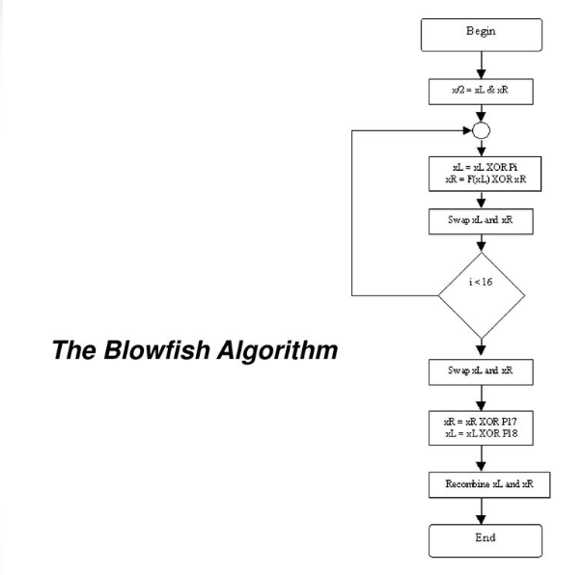

Slide 10
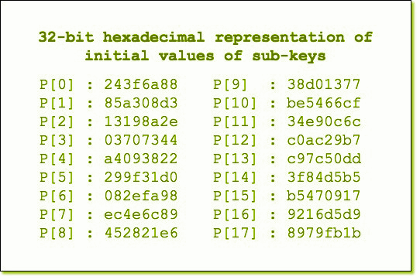
P[i] = P[i] xor (i+1)th 32-bits of input key

Slide 11
Products that use Blowfish
Though it is not as secure as other symmetric encryption algorithms, many products in many different areas of the Internet utilize Blowfish. Different types of products that Blowfish is a part of are:
Password Management Password management software and systems protect and create passwords. Blowfish has been used in a variety of password management tools to both create passwords and encrypt saved passwords. Used in Web Confidential
File/Disk Encryption Software that encrypts files or disks is extremely common today as so many organizations have sensitive data they need to keep secure. This software must be straightforward for use by companies and quick to finish the encryption process.

Slide 12
Backup Tools Software that backs up vital infrastructure in an organization must have the ability to encrypt information in those backups.
Email Encryption Encryption for emails is extremely important on any device. Different IOS, Linux, and Windows software all use Blowfish for email encryption.
Secure Shell (SSH) Secure Shell is used to remotely access computer networks while authenticating the user through the use of encryption methods like Blowfish. Examples:
OpenSSH

Slide 13
Advantages :
40-bit key algorithms are useless as they can be "cracked" within a few hours by an average personal computer.
64-bit algorithms are safe today but will become threatened as technology evolves.
128-bit and over algorithms are almost unbreakable. In other words, it would take millions of years to try every possible combination of bits in a 128-bit key.
lesser amount of operations to complete compared to other encryption algorithms.
The key schedule of Blowfish takes a long time, but this can be advantageous, as brute force attacks are more difficult

Slide 14
Disadvantages
The key schedule of Blowfish takes a long time, equivalent to encrypting 4KBs of data, which can take a very long time to do The small block size of Blowfish means that Birthday Attacks can occur and compromise the encryption algorithm It is followed by Twofish, which was created to replace Blowfish, as it is better in most ways.

Slide 15
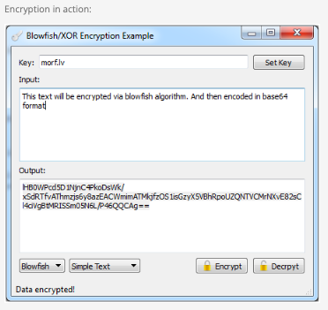
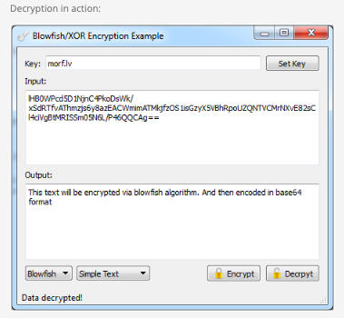

Slide 16

Notes:
works:
Key Expansion: Blowfish uses a key expansion algorithm to generate a series of subkeys from the original key. It starts by initializing a 576-bit P-array with the hexadecimal digits of pi, and then XORs the subkeys with the key in a repetitive manner.
Encryption:
Blowfish divides the 64-bit block into two halves, left (L) and right (R).
The block goes through 16 rounds of encryption. Each round performs the following operations on L and R:
XOR L with the subkey associated with the current round.
Apply the Blowfish Feistel function to the result: F(R).
Swap L and R.
After the 16 rounds, swap L and R one final time.
Decryption: The decryption process is similar to encryption but uses the subkeys in reverse order.
Weaknesses of Blowfish:
Limited Block Size: Blowfish operates on fixed 64-bit blocks. This can be a limitation when dealing with large data streams or when encrypting patterns that are smaller than the block size.
Known Weak Keys: Blowfish has certain weak keys that can result in a compromised encryption process. These weak keys should be avoided to maintain the security of the algorithm.
Susceptibility to Linear Cryptanalysis: Blowfish is somewhat vulnerable to linear cryptanalysis, which is a statistical attack that can exploit linear relationships between the plaintext, ciphertext, and key. However, it is important to note that linear cryptanalysis still requires a considerable number of known plaintext-ciphertext pairs.
Limited Adoption: Blowfish has not seen widespread adoption compared to other symmetric encryption algorithms like AES (Advanced Encryption Standard). Its limited usage and scrutiny may introduce potential vulnerabilities that remain undiscovered.

Slide 17
RESOURCES
https://www.techtarget.com/searchsecurity/definition/Blowfish
https://www.geeksforgeeks.org/blowfish-algorithm-with-examples/
https://github.com/AdityaMalani/Blowfish-algorithm-python
https://github.com/prophet6250/blowfish-implementation
https://www.encryptionconsulting.com/education-center/what-is-blowfish
htps://one2backup.com/blowfishencryption.aspx

Slide 18
Thank you
Notes:
works:
Key Expansion: Blowfish uses a key expansion algorithm to generate a series of subkeys from the original key. It starts by initializing a 576-bit P-array with the hexadecimal digits of pi, and then XORs the subkeys with the key in a repetitive manner.
Encryption:
Blowfish divides the 64-bit block into two halves, left (L) and right (R).
The block goes through 16 rounds of encryption. Each round performs the following operations on L and R:
XOR L with the subkey associated with the current round.
Apply the Blowfish Feistel function to the result: F(R).
Swap L and R.
After the 16 rounds, swap L and R one final time.
Decryption: The decryption process is similar to encryption but uses the subkeys in reverse order.
Weaknesses of Blowfish:
Limited Block Size: Blowfish operates on fixed 64-bit blocks. This can be a limitation when dealing with large data streams or when encrypting patterns that are smaller than the block size.
Known Weak Keys: Blowfish has certain weak keys that can result in a compromised encryption process. These weak keys should be avoided to maintain the security of the algorithm.
Susceptibility to Linear Cryptanalysis: Blowfish is somewhat vulnerable to linear cryptanalysis, which is a statistical attack that can exploit linear relationships between the plaintext, ciphertext, and key. However, it is important to note that linear cryptanalysis still requires a considerable number of known plaintext-ciphertext pairs.
Limited Adoption: Blowfish has not seen widespread adoption compared to other symmetric encryption algorithms like AES (Advanced Encryption Standard). Its limited usage and scrutiny may introduce potential vulnerabilities that remain undiscovered.

